Slide 1
DK, Simply Artificial Intelligence, DK Publishing, 2023
History of Artificial Intelligence
Classical Artificial Intelligence
Statistical Artificial Intelligence
Using Artificial Intelligence
Philosophy of Artificial Intelligence
Living with Artificial Intelligence

Slide 2
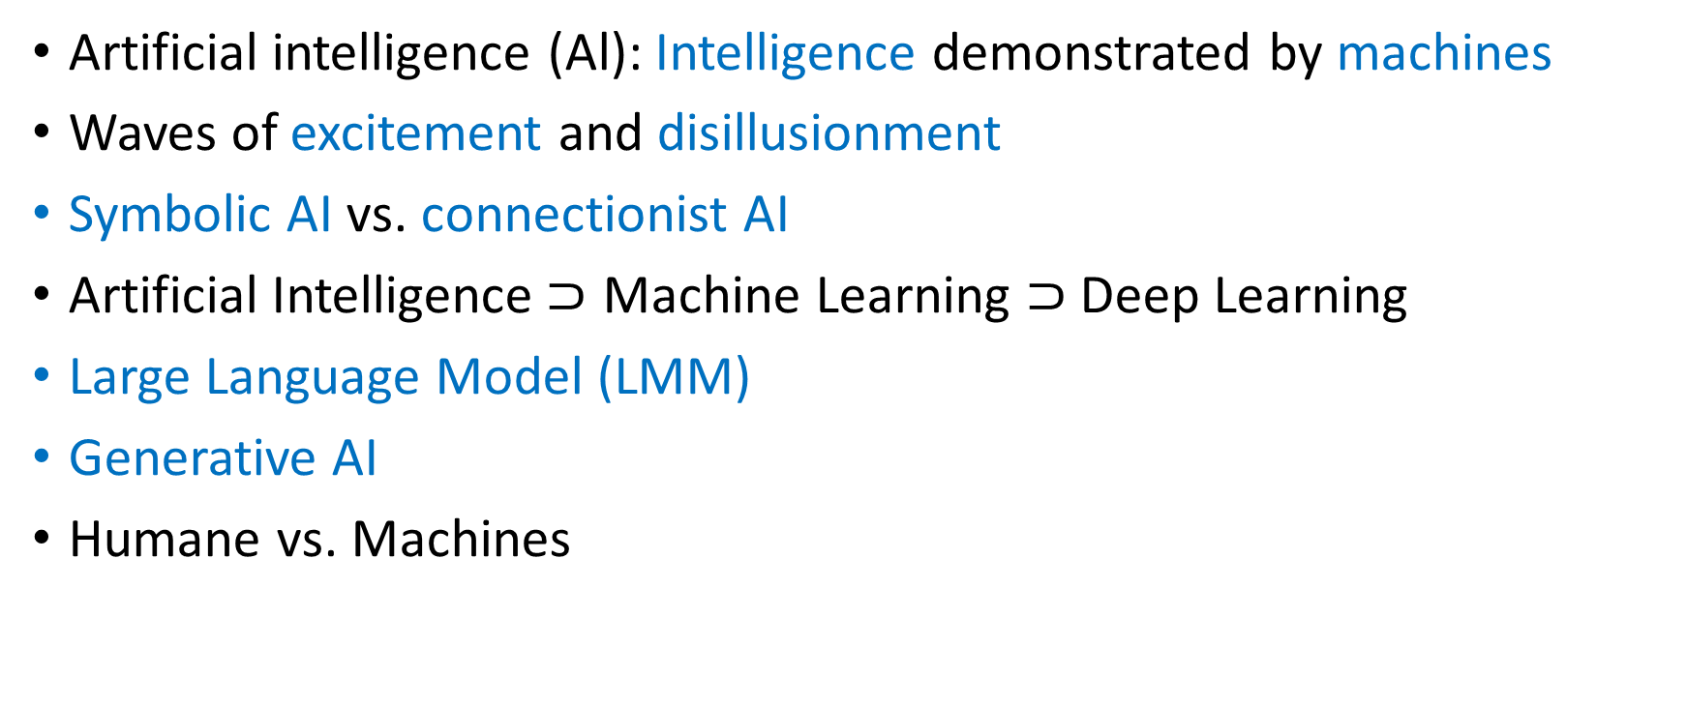
WHAT IS ARTIFICIAL INTELLIGENCE?
Artificial intelligence (Al): Intelligence demonstrated by machines
Waves of excitement and disillusionment
Symbolic AI vs. connectionist AI
Artificial Intelligence$⊃$ Machine Learning $⊃$ Deep Learning
Large Language Model (LMM)
Generative AI
Humane vs. Machines

